Slide 1
Final Project Presentation
(Phase 1)
Vast Challenge 1 From 2019 Crowdsourcing For Situational Awareness
Harsh Panday (panday.4)
Muskan Jain (jain.727)
Srivardhan Reddy kalli (kalli.1)

Slide 2
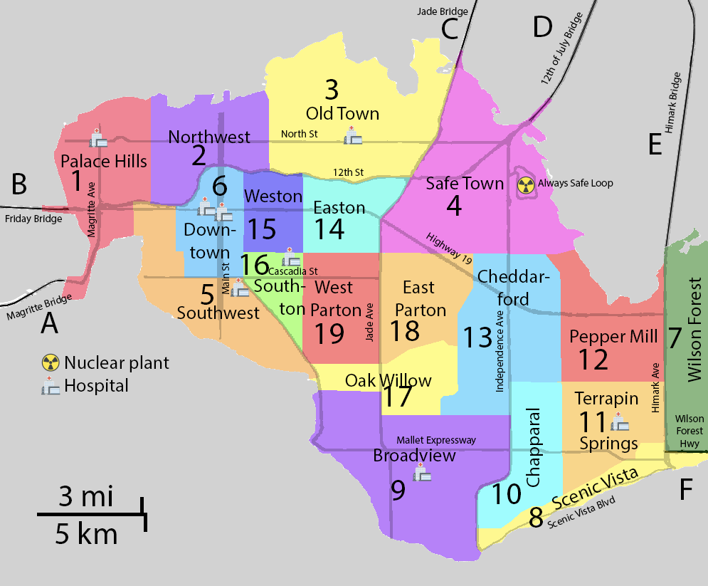
Scenario
St. Himark has been hit by an earthquake, leaving officials scrambling to determine the extent of the damage and dispatch limited resources to the areas in most need. They quickly receive seismic readings and use those for an initial deployment but realize they need more information to make sure they have a realistic understanding of the true conditions throughout the city.
In a prescient move of community engagement, the city released a new damage-reporting mobile application shortly before the earthquake. This app allows citizens to provide more timely information to the city to help them understand the damage and prioritize their response. In this mini-challenge, use app responses in conjunction with shake maps of the earthquake strength to identify areas of concern and advise emergency planners.

Slide 3
Data
For this challenge we are given a dataset spanning the entire length of the event. It contains reports submitted by users of the shake intensity and the overall damage done by the earthquake in their respective neighborhoods in categorical form.
Fields of the dataset:
time: timestamp of incoming report/record, in the format YYYY-MM-DD hh:mm:ss
location: id of neighborhood where person reporting is feeling the shaking and/or seeing the damage
{shake_intensity, sewer_and_water, power, roads_and_bridges, medical, buildings}: reported categorical value of how violent the shaking was/how bad the damage was (0 - lowest, 10 - highest; missing data allowed)
Time of report
Various categories and their intensity users can report
Location of user

Slide 4
Data Analysis

Slide 5
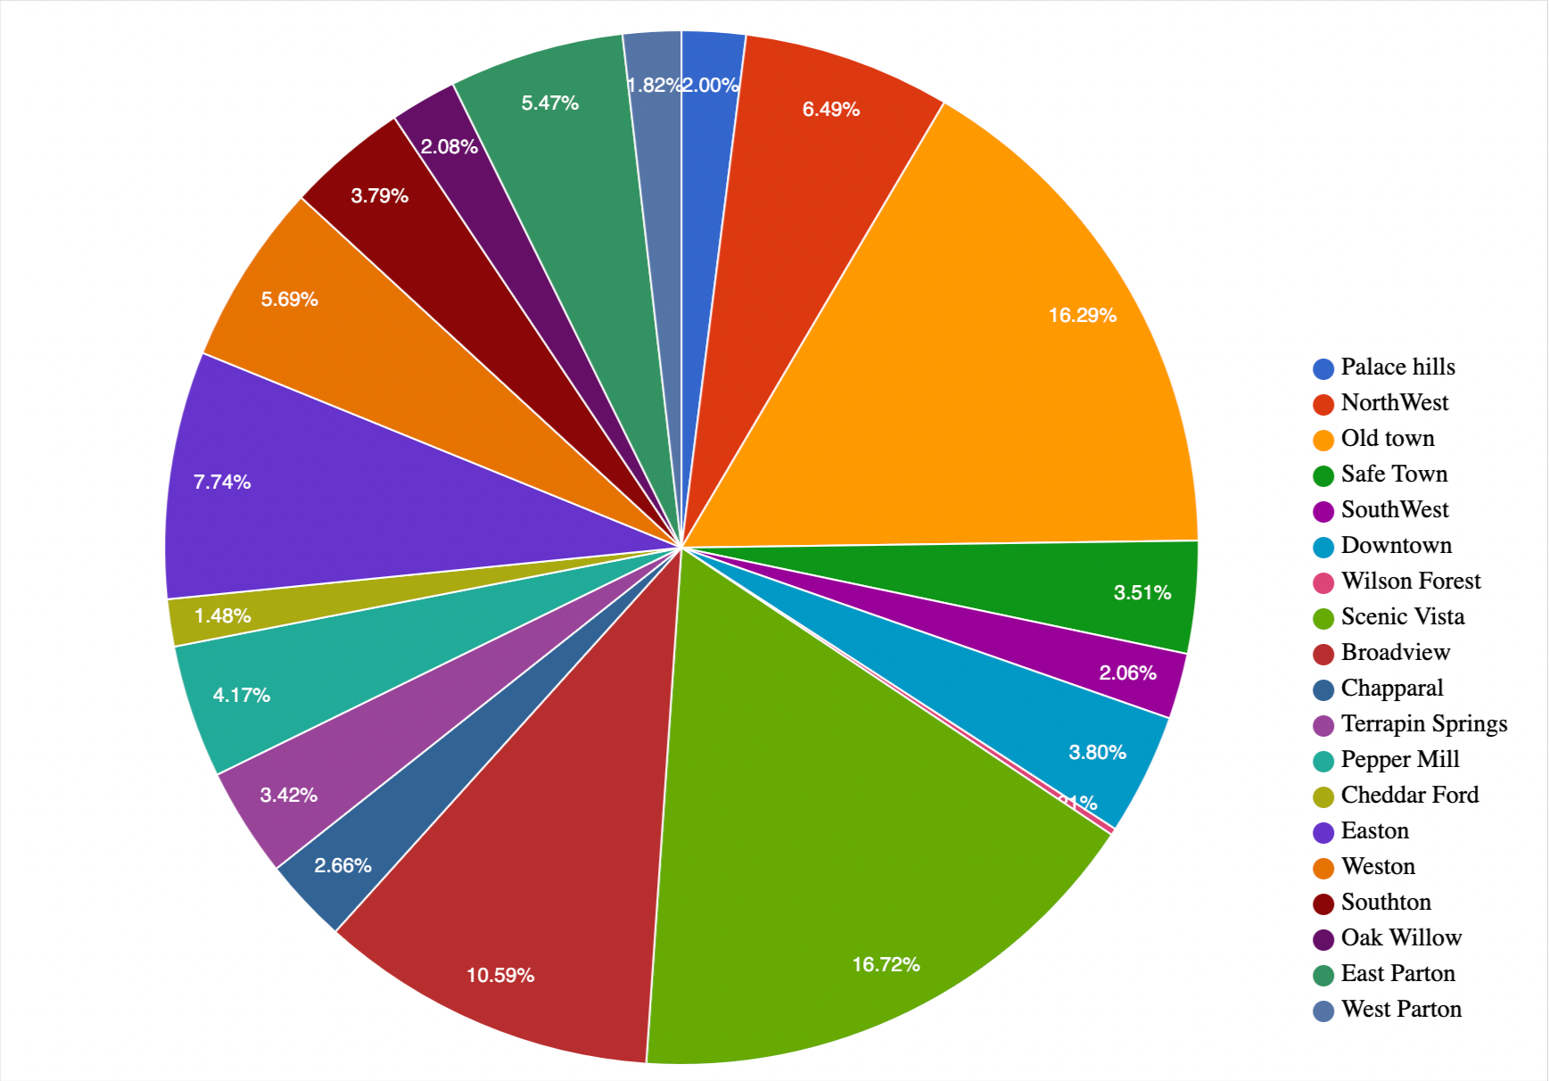
Population
Population distribution is an important factor in scenarios like this as it will allow the response team to decide where to allocate more resources.
Since we are not given the population distribution of St.Himark in the data, we used the number of reports from an area to get an approximation of the population distribution.
From the distribution shown in the pie-chart beside we can see that area’s like Scenic Vista (location 8)and Old town (location 3)have the majority of the population so both of these areas should have more resources allocated towards them to maximise the number of people getting help..

Slide 6
Infrastructure
To determine which locations are more earthquake sensitive we studied the city description very carefully and came to the following conclusions:
The most important infrastructure is the Always Safe Nuclear Power Plant in Safe Town as it provides 72% of St. Himark’s electricity and provides job to 700 highly skilled professionals.
Another important infrastructure is the Hospitals located in Palace Hills, Old Town, Downtown, Broadview, Terrapin and Southton. During a time of crisis like this hospitals can provide critical care to the injured.

Slide 7
Our Approach

Slide 8
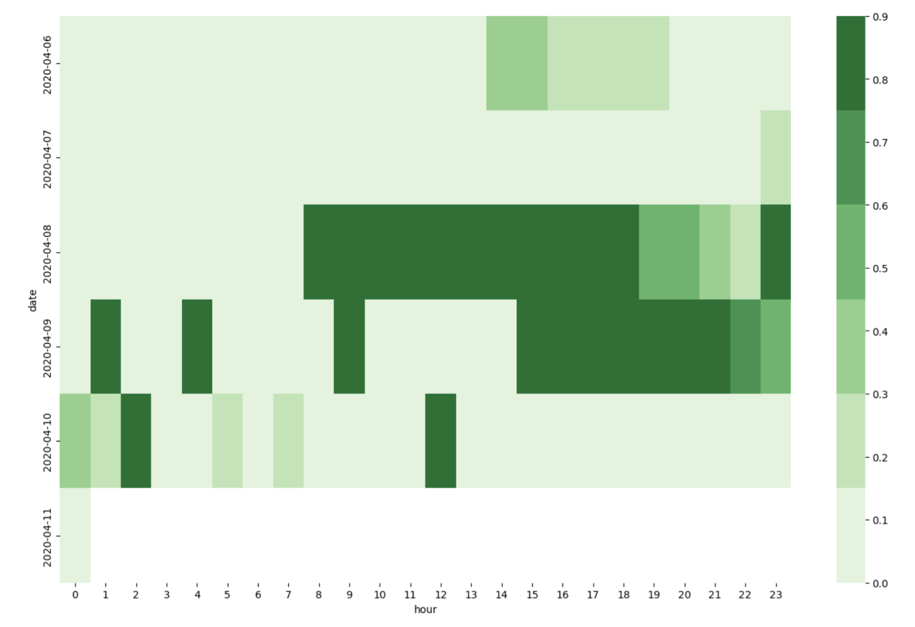
Intensity of the Earthquake
First we wanted to determine the dates and times when the major shakes were felt by the people as the response team need to provide immediate relief after the major shake.
The heat map beside shows the mean shake_intensity reported by users by time and date.
We can see that the citizens felt high intensity shake on the the afternoon if 2020-04-08 and some high intensity aftershocks on morning of 2020-04-09 and 2020-04-10. So this is time the response team need to the most alert to provide help.

Slide 9
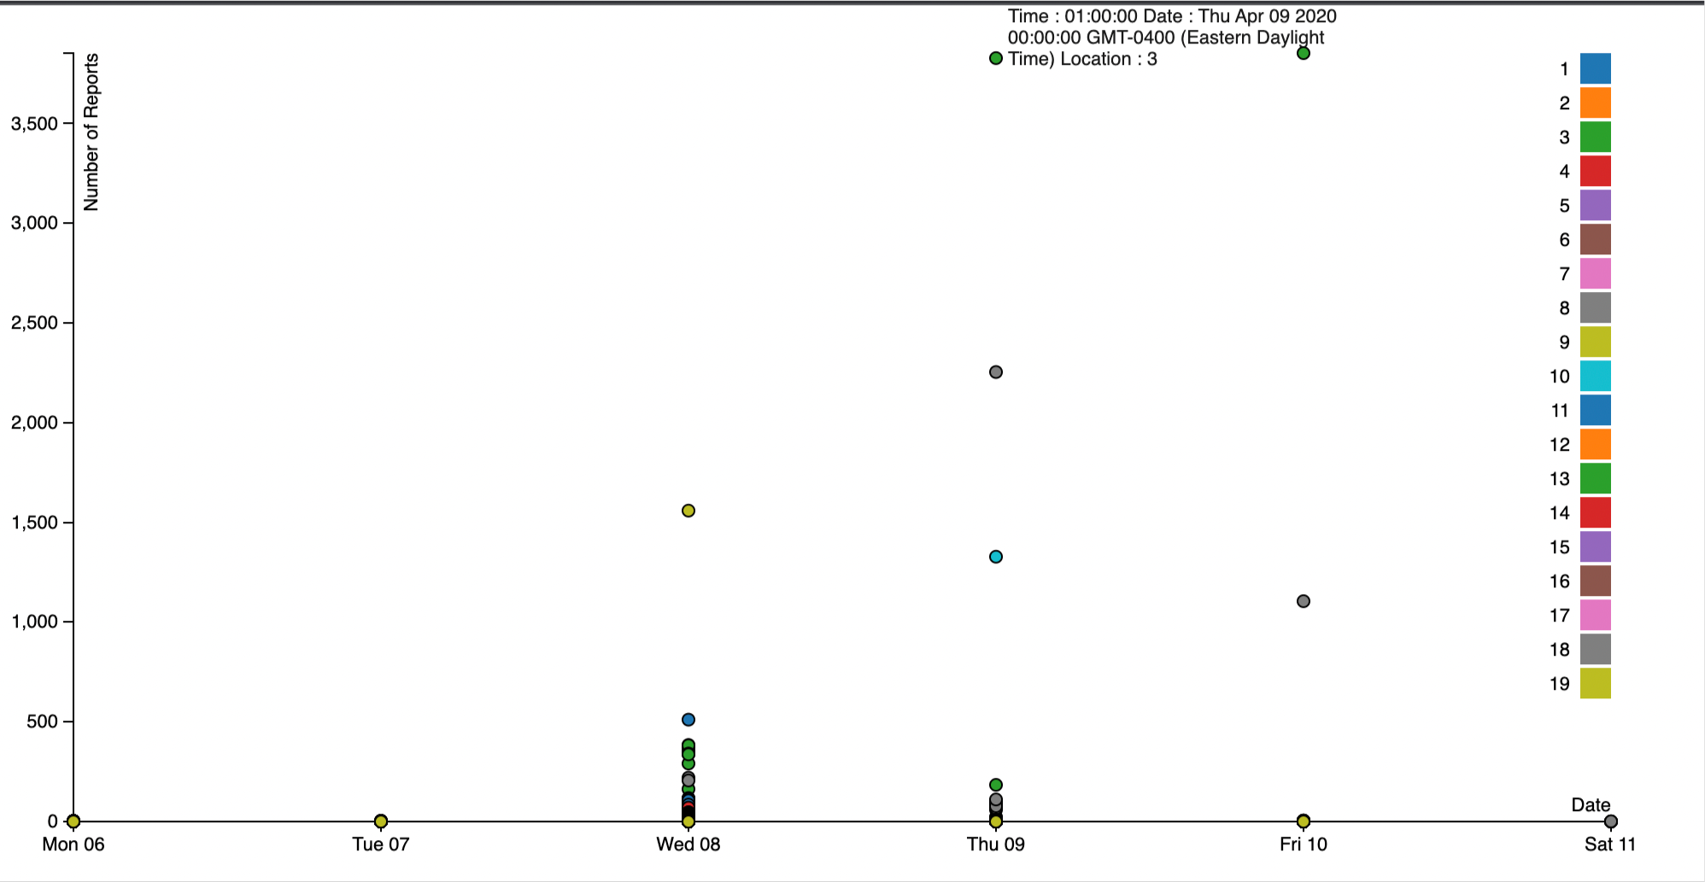
Power Outage
One of the most important things in a crisis like this is power. Power is needed for everything but most importantly for it is required for the proper functioning of the nuclear power plant and the hospitals.
In the scatter plot beside we are trying to visualize the reports made by public regarding power outage (power>=8.0). As you can see most of the locations reported power outage on 2020-04-08 . This makes sense as in the heatmap before we saw the main shocks of the earthquake were felt on 2020-04-08.
We can noticed that some locations had a lot of reports of power outage on Thursday and Friday i.e 2020-04-09 and 2020-04-10. Power lines of these areas must be destroyed in the earthquake, so the response team should send someone to fix those power lines ASAP.

Slide 10
Analytical Questions
After our initial data analysis we were already able to answer the following questions:
Q: How will neighborhoods be prioritized for a response?
Ans: The neighborhood we should prioritize are the ones with the nuclear power plant and the ones with hospitals i.e. Safe Town, Palace Hills, Old Town, Downtown, Broadview, Terrapin and Southton.
Q: Which area’s reported more power outage?
Ans: Location 3 and 8 i.e.Old Town and Scenic Vista had a high number of report for power outage on 2020-04-09 and 2020-04-10.

Slide 11
Final Visualization
After analysing the problem statement and the data we decided that the best way for the response team to
Our final goal is to create an interactive dashboard for the response team, which they can use and determine the areas that need immediate help and also the kind of help that area needs.

